Slide 1
Cracking the database store
The far side of the Moon
Martin Kersten, Stefan Manegold
Centre for Mathematics and Computer Science
Amsterdam

Slide 2
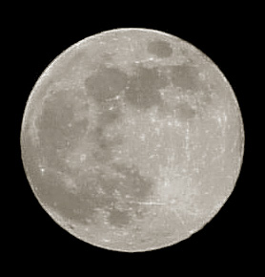

The Moon
The dark side of the moon

Slide 3
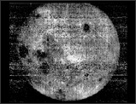
The Moon
The far side of the moon
Database research tends to look at just one side of the moon

Slide 4
Duality issues in Science
Physics
  Matter and anti-matter
Mathematics
  A graph and its dual – graph
Biology
  The DNA string of pairs
Computer science
  ???
Database technology
  ?? What is the duality architecture for query dominant settings

Slide 5
Outline
Database processing problem
  the far side of a DBMS architecture
Cracking the store issues
  Keeping track of decisions
  Optimizer issues
A multi-step query benchmark
  You can’t improve what you can’t measure
Realization & evaluation
  Legacy technology blocks progress …?
Outlook

Slide 6
The moon

Slide 7
DBMS architecture
SQL mgr
create table
Qry mgr
Table mgr

Slide 8
DBMS architecture
SQL mgr
insert into table
Qry mgr
Table mgr

Slide 9
DBMS architecture
SQL mgr
select * from table where pred
optimize
Qry mgr
scan
Table mgr

Slide 10
DBMS architecture
SQL mgr
create index on table
Qry mgr
scan
Table mgr

Slide 11
DBMS architecture
SQL mgr
select * from table where pred
optimize
Qry mgr
scan
Table mgr

Slide 12
DBMS architecture
SQL mgr
Insert into table
Qry mgr
scan
Table mgr

Slide 13
DBMS architecture
SQL mgr
select * from table where pred
optimize
Qry mgr
Observations:
The DBA decides on the indices
Maintenance cost is taken during update
Queries have ‘uniform’ good access
scan
Table mgr

Slide 14
DBMS architecture
SQL mgr
create table
create table
SQL mgr
Qry mgr
Qry mgr
Table mgr
Table mgr

Slide 15
DBMS architecture
SQL mgr
insert into table
insert into table
SQL mgr
Qry mgr
Qry mgr
Table mgr
Table mgr

Slide 16
DBMS architecture
select * from table where pred
select * from table where pred
SQL mgr
SQL mgr
Optimize
access
Optimize access &
Reorganize table
Qry mgr
Qry mgr
scan
scan
Table mgr
Table mgr

Slide 17
DBMS architecture
select * from table where pred
SQL mgr
Create index on table
SQL mgr
Qry mgr
Qry mgr
answer
Q1
rest
Table mgr
Table mgr

Slide 18
DBMS architecture
select * from table where pred
select * from table where pred
SQL mgr
SQL mgr
optimize
Optimize &
reorganize
Qry mgr
Qry mgr
answer
Q1
rest
Table mgr
Table mgr

Slide 19
DBMS architecture
SQL mgr
select * from table
select * from table
SQL mgr
optimize
Qry mgr
Qry mgr
scan
Q1
Table mgr
Table mgr

Slide 20
DBMS architecture
SQL mgr
Insert into table
Insert into table
SQL mgr
Qry mgr
Qry mgr
scan
Q1
Table mgr
Table mgr

Slide 21
DBMS architecture
Observations:
The DBA decides on the indices
Maintenance cost is taken during update
Queries have ‘uniform’ good access
Observations:
The DBA does not decide on the indices
Maintenance cost is taken during query
Updates have ‘uniform’ good access

Slide 22
This is crazy
Reorganization is utterly expensive
This ultimately leads to 1-tuple tables (partitions)
Better to have many (update) users pay less then one (query) user a lot
It defeats the role of a query optimizer….
It does not fit the Volcano-style query processor..
It just doesn’t work that way…….

Slide 23
What if it isn’t crazy?
Database hotspot is properly indexed with fast access, incrementally faster cracking
Simplifies the query optimizer to finding the right piece, query tracks are carved in the database
Natural fragmentation appears for use in a grid setting
Supports incremental construction using ordinary distributed database techniques

Slide 24
Cracking the database store
Research hypothesis:
  It is feasible to take database cracking as a basis for physical database organization
  It can be made performance competitive
CIDR contribution:
  How to keep track of the database parts ?
  What are the optimizer issues ?
  Can we measure performance improvements ?
  Simulation using micro-benchmark ?
  How expensive is it to save a result in a new table?
  What kernel extensions are required ?

Slide 25
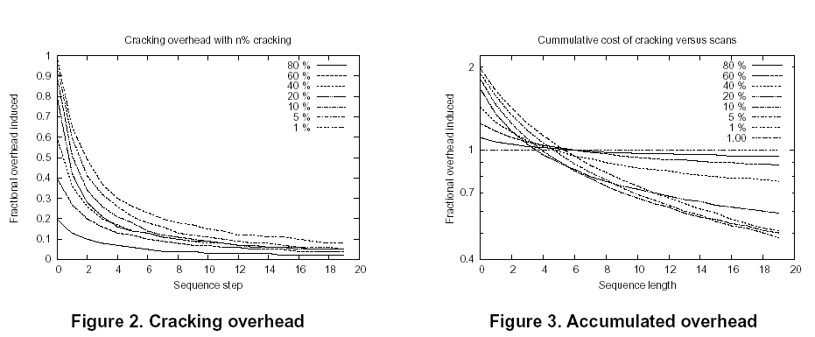
Micro-benchmark
- Simulation result confirm theoretical expectation

Slide 26



Cracker lineage
Cracking can be aligned with the relational algebra operators
  Psi-cracking
    produces two vertical fragments for each projection
  Phi-cracking
    produces two horizontal fragments for each selection
  Diamond-cracking
    produces the derived fragmentation for each join
  Omega-cracking
    a horizontal fragmentation based on the grouping attributes
…

Slide 27
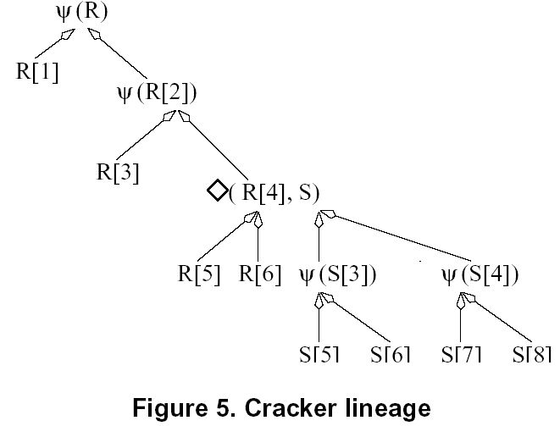
Cracker lineage
Select * from R where R.a<10

Slide 28
Cracker lineage
Select * from R where R.a<10
Select * from R,S where R.k=S.k and R.a<5

Slide 29
Cracker lineage
Select * from R where R.a<10
Select * from R,S where R.k=S.k and R.a<5
Select * from S where S.b>25

Slide 30
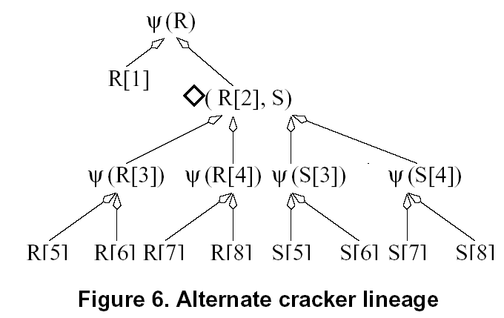
Cracker lineage
Select * from R where R.a<10
Select * from R,S where R.k=S.k and R.a<5
Select * from S where S.b>25

Slide 31
Cracker lineage
Arbitrary cracking an n-ary relation results in an exponential number of pieces
  Every projection produces 2 pieces
  Every selection produces >=2 pieces
  Every equi join produces 4 pieces
  Every aggregate produces K pieces
Cracking the database store calls for optimization decisions
  To limit the number of fragments
  To reduce the reorganization cost
  To avoid cracker administration overhead
This optimization issue is still an open area for research
  How to measure progress?

Slide 32
A multi-step query benchmark
You can’t improve what you can’t measure
Requirements:
  Simple database structure
  Scaleable
  Controllable generation of multi-query sequences
  Examples:
  Home run Walker Strolling

Slide 33
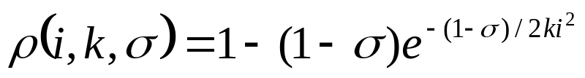
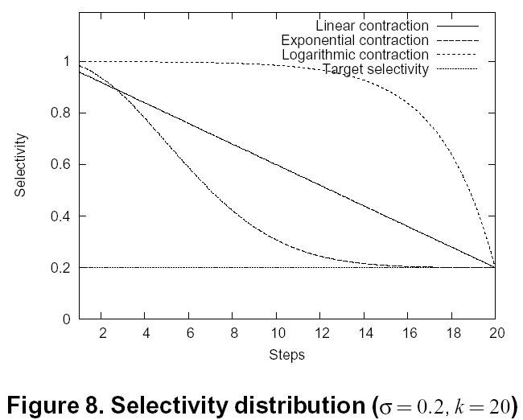
A multi-step query benchmark
Sequences are controlled by length and contraction factor
Homerun:

Slide 34
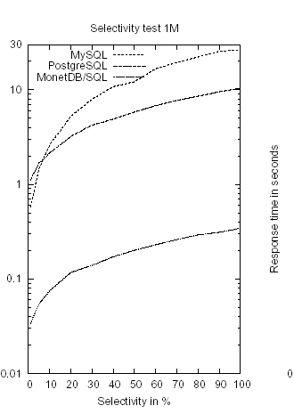
Micro-benchmark
Keeping the query result in a new table is often too expensive
A light-weight index structure is needed!
MonetDB/SQL | 0.34 N | 44
MySQL | 25.1 N | 238
PostgreSQL | 10.6 N | 1230
Commercial | 39.0 N | 800
In milliseconds/K
Fixed cost in milleseconds

Slide 35
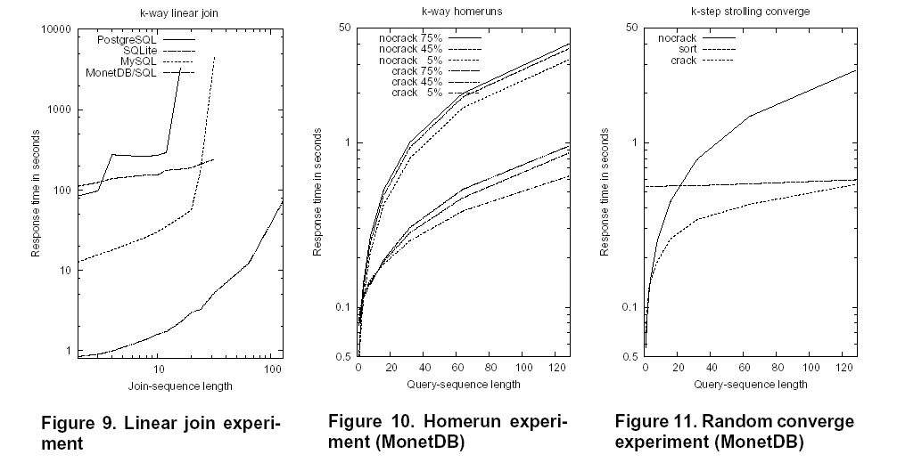
Realization & evaluation
Cracking produces a lot of fragments to be glued together using union and join.
MySQL, PostgreSQL,.. Call for large investment to handle lengthy joins
A cracker index with supportive operations is a necessity !

Slide 36
Realization & evaluation
Realization of a cracker index in MonetDB/SQL
  About 5 pages of C
  Homerun experiment
  Strolling experiment
Cracker index works!
Cumulative cost
  Below sorting
  Better than naive

Slide 37
Future research
Cracking becomes an integral part of the MonetDB 5.0 experimentation platform to control resource management
It is the basis for organically distributed databases
Many, many implementation and optimization issues
  When to stop cracking ?
  When to fuse pieces that become too small ?
  ….

Slide 38
Conclusions
Cracking a database store is a paradigm wide open for further detailed investigation
It complements current technology
The far side of the moon

Slide 39
Conclusions
MonetDB 4.4 is available
  fully functional SQL DBMS
  ODBC,JDBC,Perl,Python,…
  Embedded version
  XQuery officially release scheduled for March’05
  http://www.monetdb.com
  And on sourceforge
The far side of the moon

Slide 40
Questions

